Slide 1
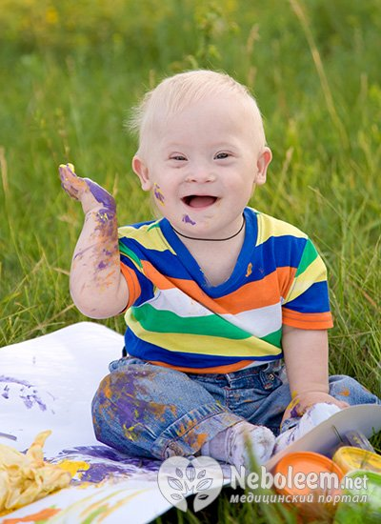
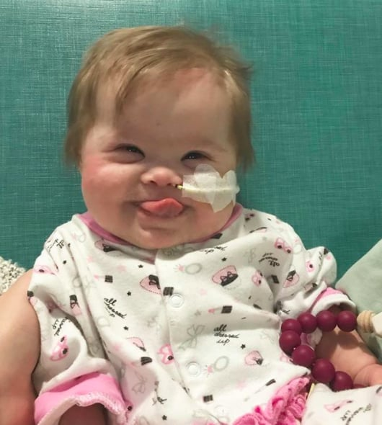
Down Syndrome
Fatema Ali Al-Qartoubi

Slide 2
When Down Syndrome Discovered?
Down syndrome, named after John Langdon Down, the British physician who described the syndrome in 1866.
Down syndrome is the commonest autosomal chromosomal anomaly with an incidence of 1 in 800 to 1000 live births in all races and economic groups.
It is a chromosomal disorder caused by an error in cell division resulting in the presence of an additional third chromosome 21 or trisomy 21.

Slide 3
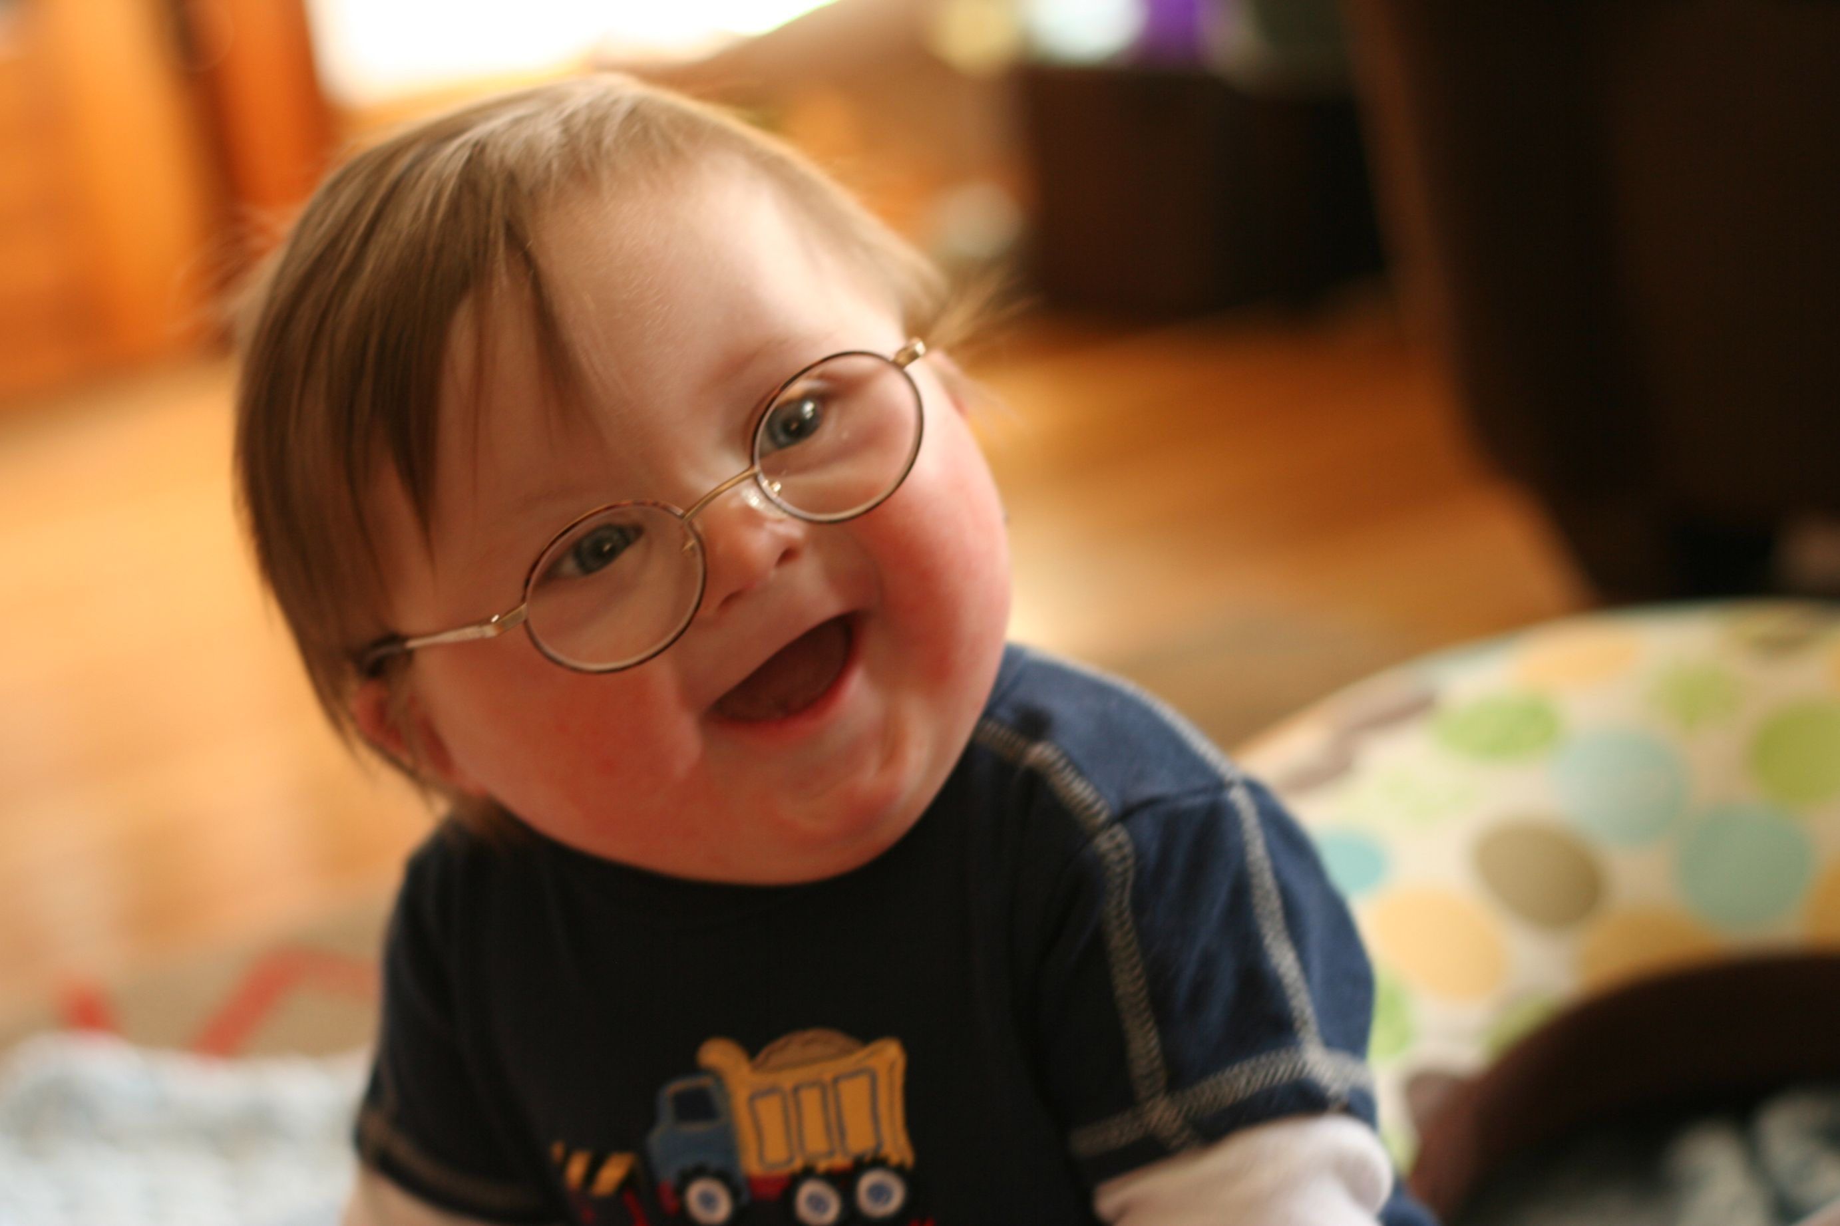
What is Down Syndrome?
The problem occurs sometime shortly after fertilization; during the phase when cells are dividing rapidly.
One cell divides abnormally, creating a line of cells with an extra chromosome 21.
This form of genetic disorder is called a Mosaic.
Translocation - During cell division, the number 21 chromosome somehow breaks. A piece of the number 21 chromosome then becomes attached to another chromosome. Each cell still has 46 chromosomes, but the extra piece of chromosome 21 results in the signs and symptoms of Down syndrome. Translocations occur in about 3-4 percent of cases of Down syndrome.

Slide 4
What is Down Syndrome?
It is typically associated with a delay in cognitive ability (mental retardation, or MR) and physical growth, and a particular set of facial characteristics.
The average IQ of young adults with Down syndrome is around 50, compared to children with an IQ of 100.

Slide 5

How Common is Down Syndrome?
Down syndrome is one of the commonest chromosomal abnormalities known today. Internationally, the birth prevalence is estimated to be 1 in 600 to 1 in 800. In Oman, it is 2.4 in 1000 which leads to about 120 affected births / year. (MOH, [2011]). Individuals born with Down syndrome are at risk for a number of associated medical
conditions such as congenital heart disease, impaired hearing, gastrointestinal tract anomalies, thyroid disorders and cataracts. Health care providers need to be aware of these conditions as some warrant immediate intervention and medical treatment

Slide 6
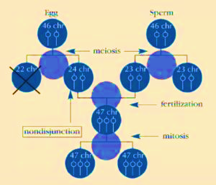
Are There Different Types of Down Syndrome?
TRISOMY 21 (NONDISJUNCTION)
this is the most common type, as it is detected in about 95% of individuals with Down syndrome. It indicates that all the cells have an extra chromosome 21. The most common error is maternal nondisjunction in the first meiotic division, with meiosis I errors occurring 3 times as frequently as meiosis II errors. The remaining causes are paternal in origin, and meiosis II errors predominate.

Slide 7
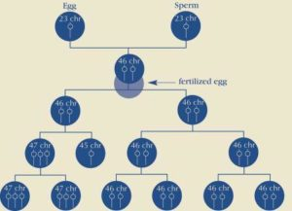
Other type:
MOSAICISM Mosaicism (or mosaic Down syndrome) is diagnosed when there is a mixture of two types of cells, some containing the usual 46 chromosomes and some containing 47. Those cells with 47 chromosomes contain an extra chromosome 21.
affecting 1-2% of individuals with Down syndrome, by which individuals have 2 cell lines; one is normal and one is trisomy 21

Slide 8
TRANSLOCATION
In translocation, which accounts for about 4% of cases of Down syndrome, the total number of chromosomes in the cells remains 46; however, an additional full or partial copy of chromosome 21 attaches to another chromosome, usually chromosome 14. The presence of the extra full or partial chromosome 21 causes the characteristics of Down syndrome.

Slide 9
What Causes Down Syndrome?
Maternal age is the only factor that has been linked to an increased chance of having a baby with Down syndrome resulting from nondisjunction or mosaicism.
80% of children with Down syndrome are born to women under 35 years of age.
There is no definitive scientific research that indicates that Down syndrome is caused by environmental factors or the parents’ activities before or during pregnancy.
can originate from either the father or the mother. Approximately 5% of the cases have been traced to the father.

Slide 10
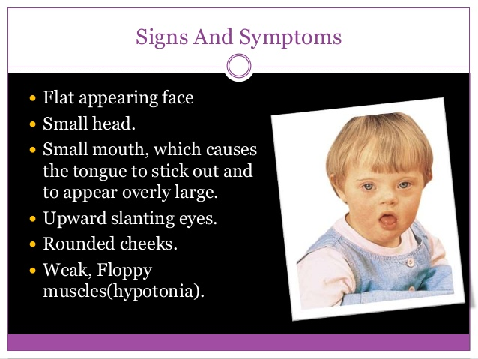
Signs And Symptoms
Flat appearing face.
Small head.
Small mouth, which causes the tongue to stick out and to appear overly large.
Upward slanting eyes.
Rounded cheeks.
Weak, Floppy muscles(hypotonia)

Slide 11
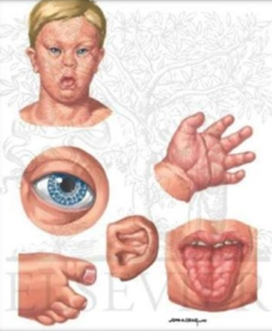
Signs And Symptoms
Small, misshapen ears.
Small, wide hands.
An unusual, deep crease across the center of the palm (called a Simian Crease).
A malformed fifth finger. ,
A wide space between the big and the second toes.
Unusual creases on the soles of the feet Overly flexible joints.
Shorter than normal height.

Slide 12
Other Defects
Congenital Heart Disease
Abnormal openings (holes) in the walls that separate the heart's chambers (Atrial septal defect).
These result in abnormal patterns of blood flow within the heart.
The abnormal blood flow often means that less oxygen is sent into circulation throughout the body.

Slide 13
Other Defects
Malformations of the Gastrointestinal
Tract The most common malformation is a narrowed, obstructed duodenum (the part of the intestine into which the stomach empties).
Duodena Atresia
The baby often vomits forcibly after feeding and cannot gain weight appropriately until the defect is repaired

Slide 14
Other Defects
Increased chance of developing Infections, especially ear infections and Pneumonia.
Certain Kidney disorders.
Thyroid disease (especially low or hypothyroid).
Hearing loss.
Vision impairment that requires corrective lenses.
A 20 - times greater chance of developing Leukemia (a blood disorder).
Because of hypotonia, babies learn to sit up, crawl, and walk much later than their normal peers.
Talking is also quite delayed

Slide 15
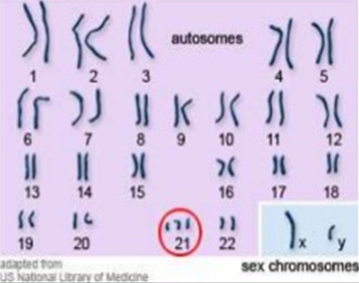
Diagnosis
Usually suspected at birth.
Genetic testing (chromosome analysis) is done to verify the presence of the disorder.
The final result of such testing, with the photographed chromosomes paired and organized by shape and size, is called the individual's Karyotype.

Slide 16
Prognosis
Is variable depending on the types of complications of each individual baby.
The severity of the retardation can also vary significantly.
Without the presence of heart defects, about 90 percent of children with Down syndrome live into their teens.
People with Down syndrome appear to go through the normal physical changes of aging more rapidly, however.
The average age at death for an individual with Down syndrome is about 50 to 55 years.
Because of modern medical treatments, including antibiotics to treat infections and surgery to treat heart defects and duodenal atresia, life expectancy has greatly increased

Slide 17

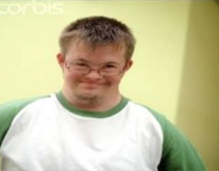
Prognosis
• Men with Down syndrome appear to be uniformly sterile (unable to have offspring).
• Women with Down syndrome, however, are fully capable of having babies. About 50 percent of these babies, however, will also be born with Down syndrome.

Slide 18


Prognosis
As people with Down syndrome age, they face an increased chance of developing the brain disease called Alzheimer's (sometimes referred to Dementia or Senility).
Most people have a six in 100 risk of developing Alzheimer's, but people with Down syndrome have a one - in - four chance of the disease

Slide 19
Treatment & Therapies
Medical Treatments:
People with Down syndrome are at increased risk for certain medical problems.
Some of the problems commonly faced by people with Down syndrome include heart defects, thyroid, muscle, joint, vision and hearing problems.
Other conditions seen less frequently in Down syndrome include leukemia, and seizures.

Slide 20
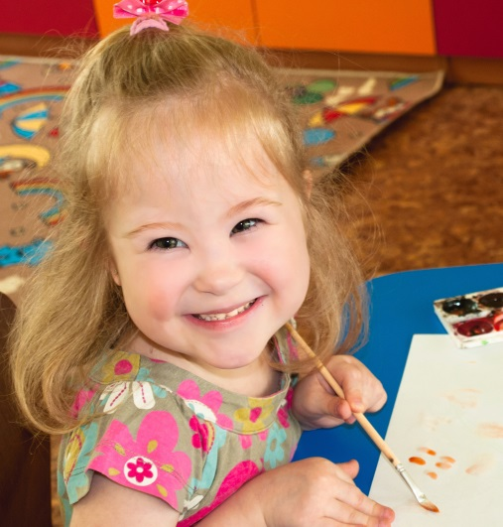
Treatment & Therapies
Medications:
Medications can be used to treat certain conditions that occur in people with Down syndrome.
For example, if a person with Down syndrome has a seizure disorder, they would benefit from taking anti - seizure medications.
People with thyroid problems often take thyroid replacement hormones.
While these medications help with their medical condition, they do not have any effect on their Down syndrome.
At this point in time, there is no medicine that will cure Down syndrome

Slide 21
Treatment & Therapies
Surgical Treatments:
Some medical conditions seen in children with Down syndrome require surgery.
For example, about 40% of children with Down syndrome have congenital heart defects.
Some of these defects are mild and may fix themselves, and some heart defects are more severe and will require surgery.
Children with Down syndrome can have intestinal defects that also require surgery.
The need for surgery does not correlate with the cognitive defect in Down syndrome.
In other words, just because a baby needs surgery, there is no reason to suspect that they have a "more severe" case of Down syndrome

Slide 22
Treatment & Therapies
Physical Therapy:
Physical therapy focuses on motor development.
Since most children with Down syndrome have hypotonia or low muscle tone, the goal of physical therapy is to teach the children with Down syndrome to move their bodies in appropriate ways, and to improve their muscle tone.
Working with their muscles and movements will help. Children reach some of their motor milestones and will prevent them from developing problems, such as bad posture, that can accompany low muscle tone

Slide 23
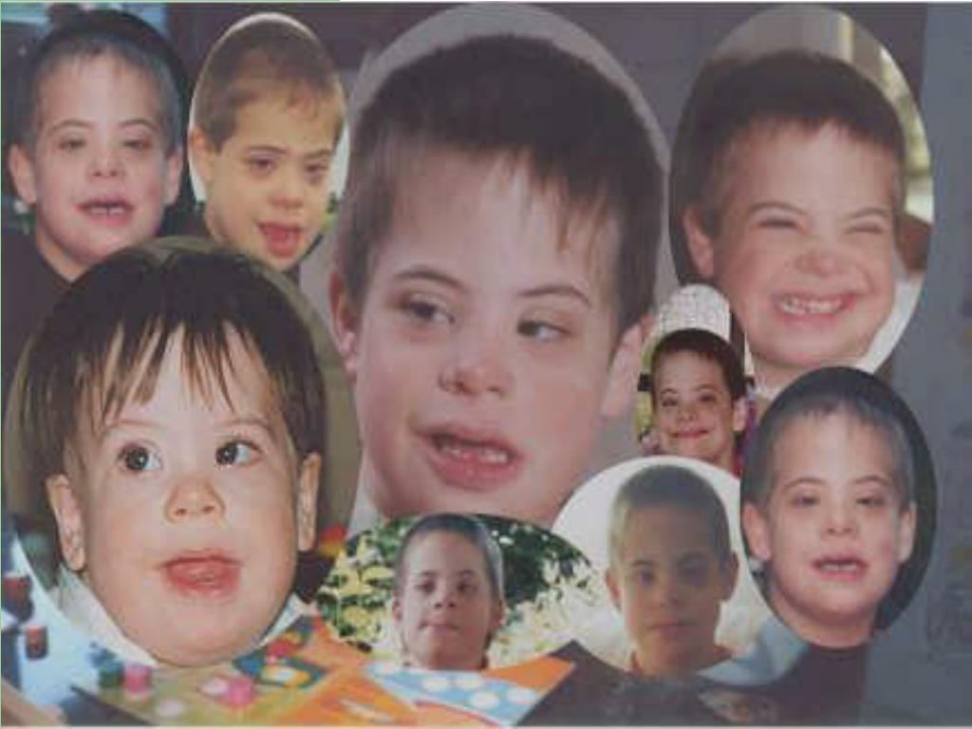
Treatment & Therapies
Speech Therapy (Young Children):
Although most children with Down syndrome learn to speak and will use speech as their primary means of communication, they will understand language and have the desire to communicate well before they are able to speak.
Because children with Down syndrome often have small mouths and slightly enlarged tongues, they can have trouble speaking clearly.
A speech therapist will work with an individual to help them learn to communicate clearly. This can be achieved through talking, or in the case of many children using sign language, pictures, and / or electronic synthesized speech can serve as a transitional communication system.

Slide 24
Treatment & Therapies
Speech Therapy (Adolescents):
SPEECH CHARACTERISTICS OF ADOLESCENTS WITH DS
Speech intelligibility (speech that can be easily understood) is one of the most difficult areas for people with Down syndrome at all ages. Many children have difficulty with the strength, timing and coordination of muscle movements for speech. Speech involves coordinating breathing (respiration), voice (phonation), and how speech sounds are produced (articulation).
ROLE OF A SPEECH - LANGUAGE PATHOLOGIST
A speech - language pathologist (SLP) can provide evaluation and treatment for the speech and language difficulties experienced by adolescents with Down syndrome. They can help develop a comprehensive treatment plan in the areas of receptive and expressive language, semantics, syntax, pragmatics, social and conversational skills, classroom language skills, etc. SLPs can work with families and teachers to help children develop effective communication skills.

Slide 25
Treatment & Therapies
Occupational Therapy:
Occupational therapists focus on the child's ability to master skills for independence. These can include:
Self care skills (feeding, dressing, grooming, etc.)
Fine and gross motor skills
skills related to school performance (eg: printing, cutting, etc.)
Play and leisure skills

Slide 26


Treatment & Therapies
WHEN THE CHILD IS AN INFANT, AN OT MAY BECOME INVOLVED TO:
Assist with oral - motor feeding problems.
Help facilitate motor milestones, particularly for fine motor skills.
Occupational therapists and Physical therapists work closely together to help the young child develop gross motor milestones (ex: sitting, crawling, standing, walking).
OTs work with the child at this stage to promote arm and hand movements that lay the foundation for later developing fine motor skills.

Slide 27
Treatment & Therapies
WHEN THE CHILD IS A TODDLER AND PRESCHOOLER, AN OT MAY BECOME INVOLVED TO:
Facilitate the development of fine motor skills.
Children do this through play, they open and close things, pick up and release toys of varying sizes and shapes, stack and build, manipulate knobs and buttons, experiment with crayons etc.
Help the child promote the beginning steps of self help skills.
An OT can suggest adaptations that might help the child be more independent. For example, a child may have more success feeding herself with a particular type of spoon and dish.

Slide 28
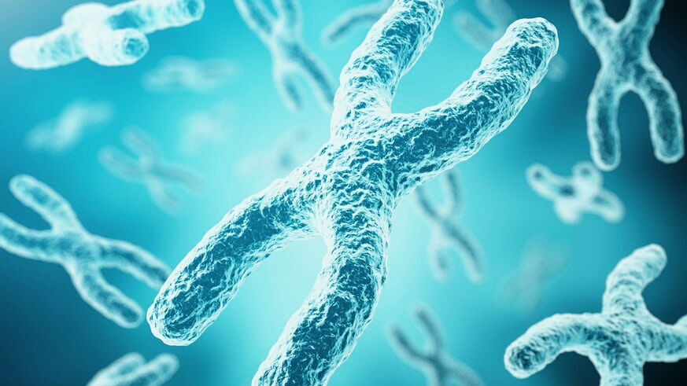
DOWN SYNDROME RESEARCHERS REMOVE EXTRA COPY OF CHROMOSOME 21 NOVEMBER 12, 2012
Geneticists from the University of Washington won a key victory in the battle against genetic diseases by successfully removing the extra chromosome 21 from cells derived from a person with Down, according to the team's report in the journal Cell Stem Cell

Slide 29
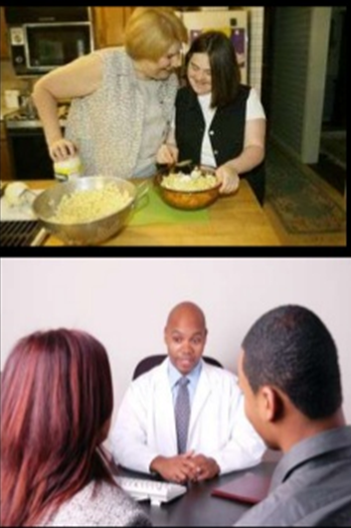
Counseling Parents of Children With DS
The primary objective in counseling parents of a child with Down's syndrome is to secure realistic goals. That is, it cannot be fully CURED.
They are NOT the cause of their child's condition.
Genetic Counseling
An accepted place in the family for the child.
A nurturing environment gives the child the best chance to reach full potential

Slide 30
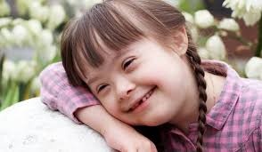
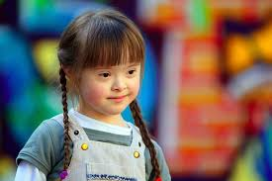

THANK
YOU!

